Slide 1
Chapter 2 Polar Covalent Bonds; Acids and Bases

Slide 2
Learning Objectives
(2.1)
Polar covalent bonds: Electronegativity
(2.2)
Polar covalent bonds: Dipole moments
(2.3)
Formal charges
(2.4)
Resonance
(2.5)
Rules for resonance forms

Slide 3
Learning Objectives
(2.6)
Drawing resonance forms
(2.7)
Acids and bases: The Brønsted–Lowry definition
(2.8)
Acid and base strength
(2.9)
Predicting acid–base reactions from pKa values
(2.10)
Organic acids and organic bases

Slide 4
Learning Objectives
(2.11)
Acids and bases: The Lewis definition
(2.12)
Noncovalent interactions between molecules

Slide 5
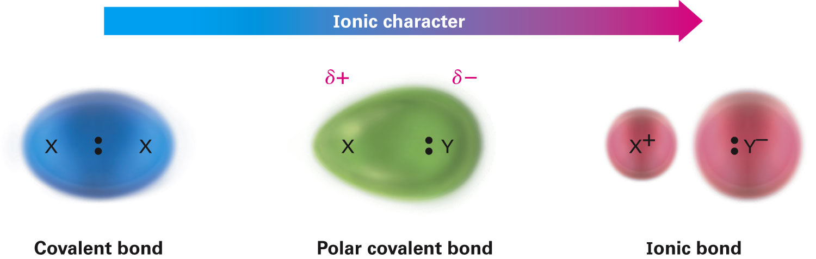
Polar Covalent Bonds: Electronegativity
Covalent bonds can have ionic character
Polar covalent bonds: Bonding electrons are attracted more strongly by one atom than by the other
Electron distribution between atoms is not symmetrical
Notes:
Polar covalent bonds: Electronegativity

Slide 6
Electronegativity
Intrinsic ability of an atom to attract the shared electrons in a covalent bond
Differences in EN produce bond polarity
F is most electronegative (EN = 4.0), Cs is least (EN = 0.7)
Metals on left side of periodic table attract electrons weakly
Halogens and other reactive nonmetals on right side of periodic table attract electrons strongly
EN of C = 2.5
Notes:
Polar covalent bonds: Electronegativity

Slide 7
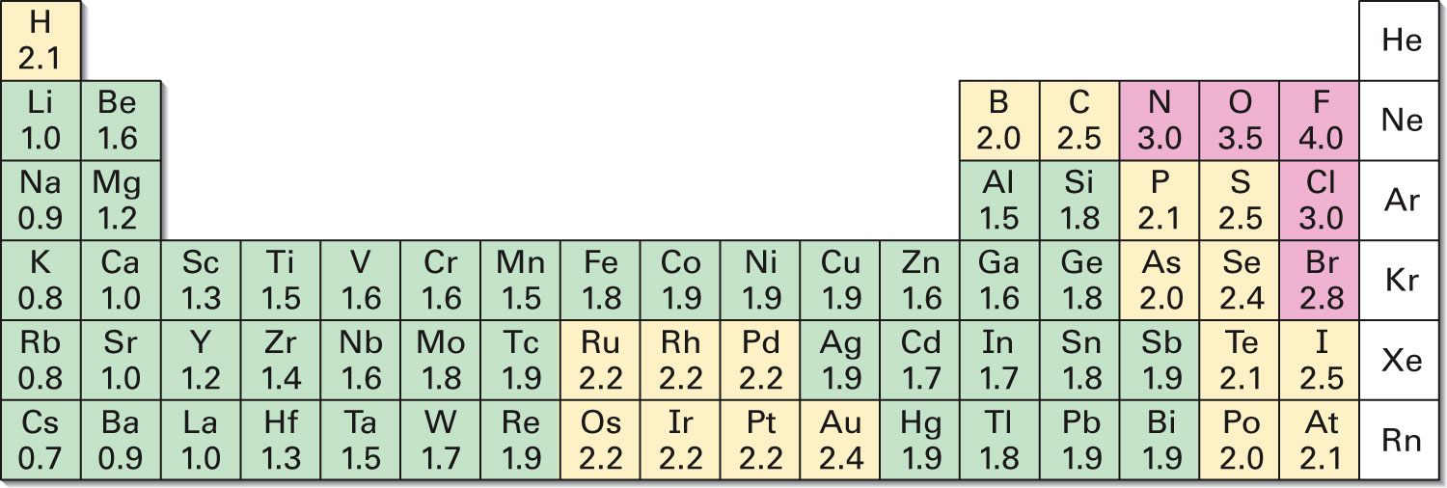
Figure 2.2 - Electronegativity Values and Trends
Notes:
Polar covalent bonds: Electronegativity

Slide 8
Bond Polarity and Inductive Effect
Difference in EN of atoms < 2 in polar covalent bonds
Difference in EN > 2 in ionic bonds
C–H bonds are relatively nonpolar
C–O, C–X bonds are polar
Bonding electrons toward electronegative atom
C acquires partial positive charge, δ+
Electronegative atom acquires partial negative charge, δ-
Inductive effect: Shifting of electrons in a σ bond in response to EN of nearby atoms
Notes:
Polar covalent bonds: Electronegativity

Slide 9
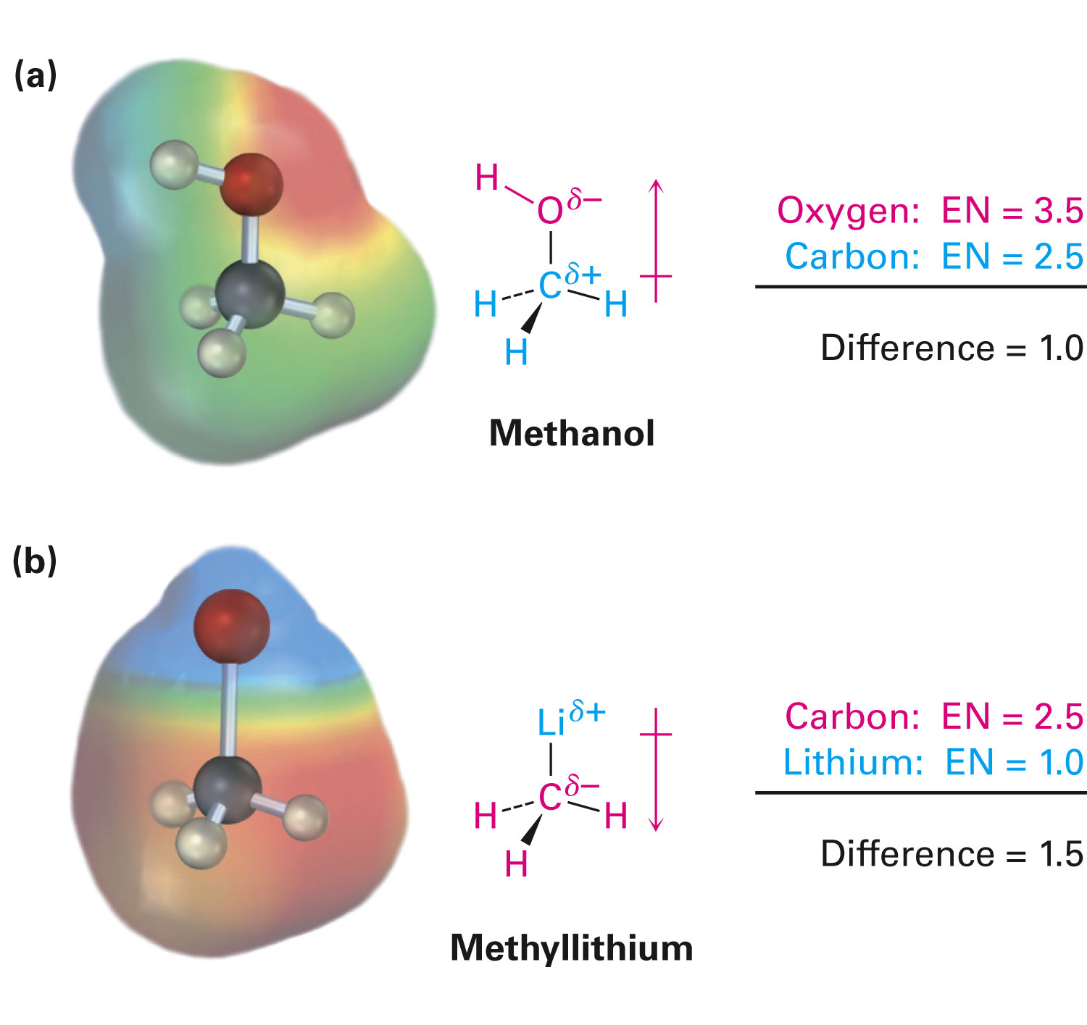
Electrostatic Potential Maps
Show calculated charge distributions
Colors indicate electron-rich (red) and electron-poor (blue) regions
Arrows indicate direction of bond polarity
Notes:
Polar covalent bonds: Electronegativity

Slide 10
Worked Example
Which element in each of the following pairs is more electronegative?
(a) Li or H
(b) Cl or I
Solution:
Using Figure 2.2
(a) Li (1.0) is less electronegative when compared to H (2.1)
(b) Cl (3.0) is more electronegative when compared to I (2.5)
Notes:
Polar covalent bonds: Electronegativity

Slide 11
Polar Covalent Bonds: Dipole Moments
Molecules are often polar from vector summation of individual bond polarities and lone-pair contributions
Strongly polar substances are soluble in polar solvents like water
Nonpolar substances are insoluble in water
Dipole moment (μ): Net molecular polarity, due to difference in summed charges
μ - Magnitude of charge Q at end of molecular dipole times distance r between charges
Notes:
Polar covalent bonds: Dipole moments

Slide 12
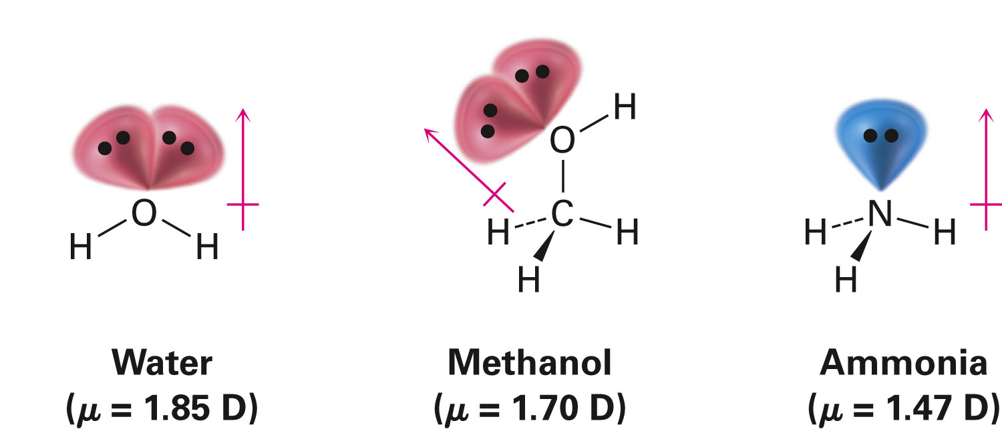
Polar Covalent Bonds: Dipole Moments
μ = Q × r, in debyes (D), 1 D = 3.336 × 10⁻³⁰ coulomb meter
Length of an average covalent bond, the dipole moment would be 1.60 × 10⁻²⁹ C⋅m, or 4.80 D
Notes:
Polar covalent bonds: Dipole moments

Slide 13
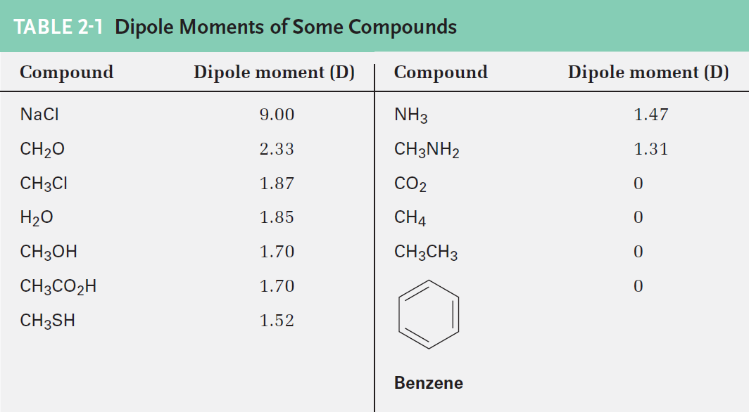
Dipole Moments in Water and Ammonia
Large dipole moments
EN of O and N > H
Both O and N have lone-pair electrons oriented away from all nuclei
Notes:
Polar covalent bonds: Dipole moments

Slide 14
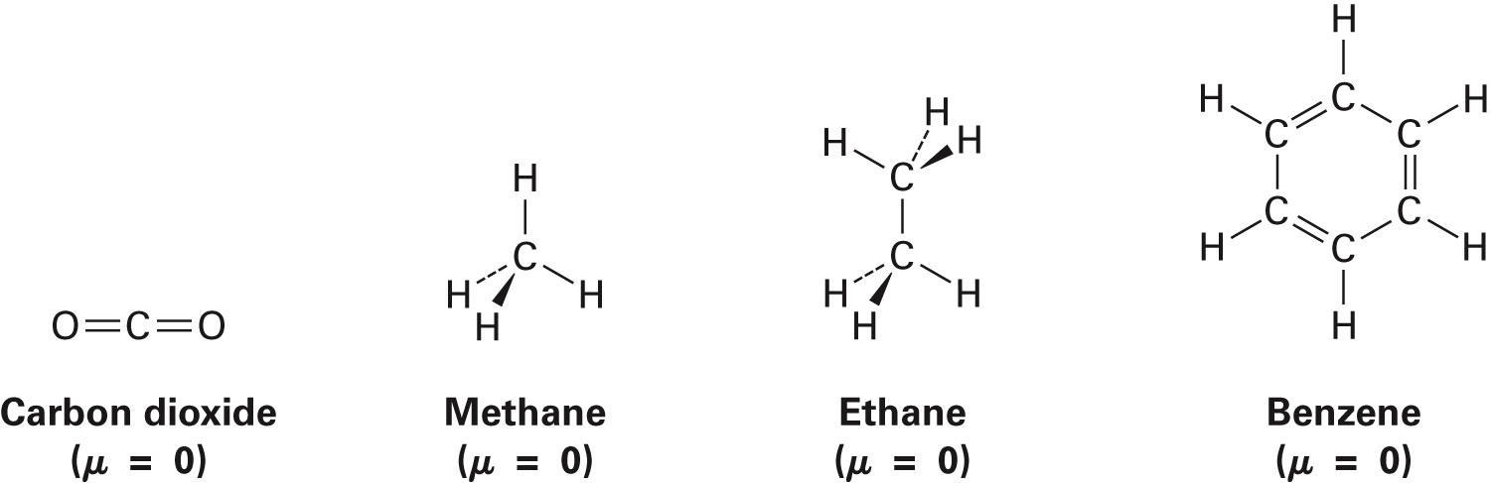
Absence of Dipole Moments
In symmetrical molecules, the dipole moments of each bond have one in the opposite direction
The effects of the local dipoles cancel each other
Notes:
Polar covalent bonds: Dipole moments

Slide 15
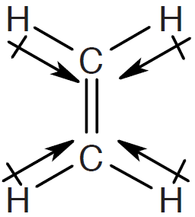
Worked Example
Draw three-dimensional drawing of H₂C═CH₂ molecules
Predict whether it has dipole moment
Solution:
Drawing an arrow that points from the least electronegative element to the most electronegative element
Has zero dipole moment
Notes:
Polar covalent bonds: Dipole moments

Slide 16
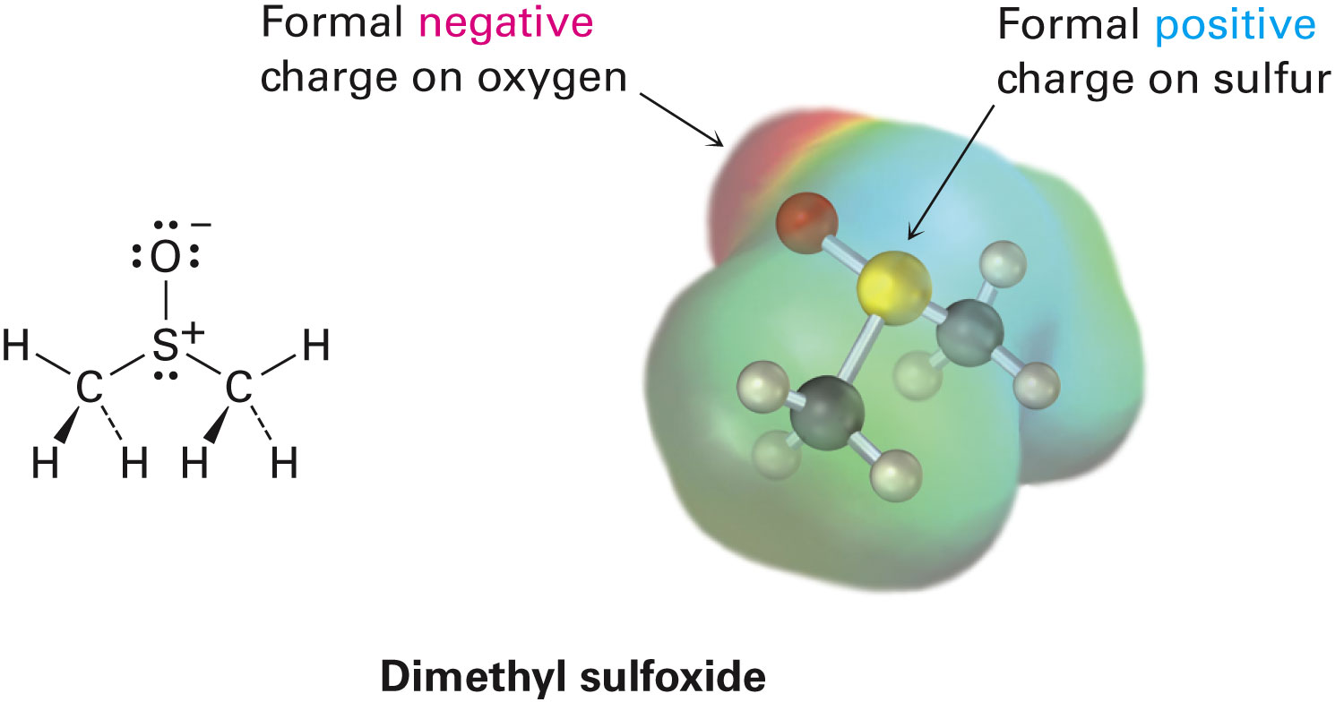
Formal Charges
At times it is necessary to have structures with formal charges on individual atoms
Bonding of the atom in the molecule is compared to valence electron structure
Notes:
Formal charges

Slide 17
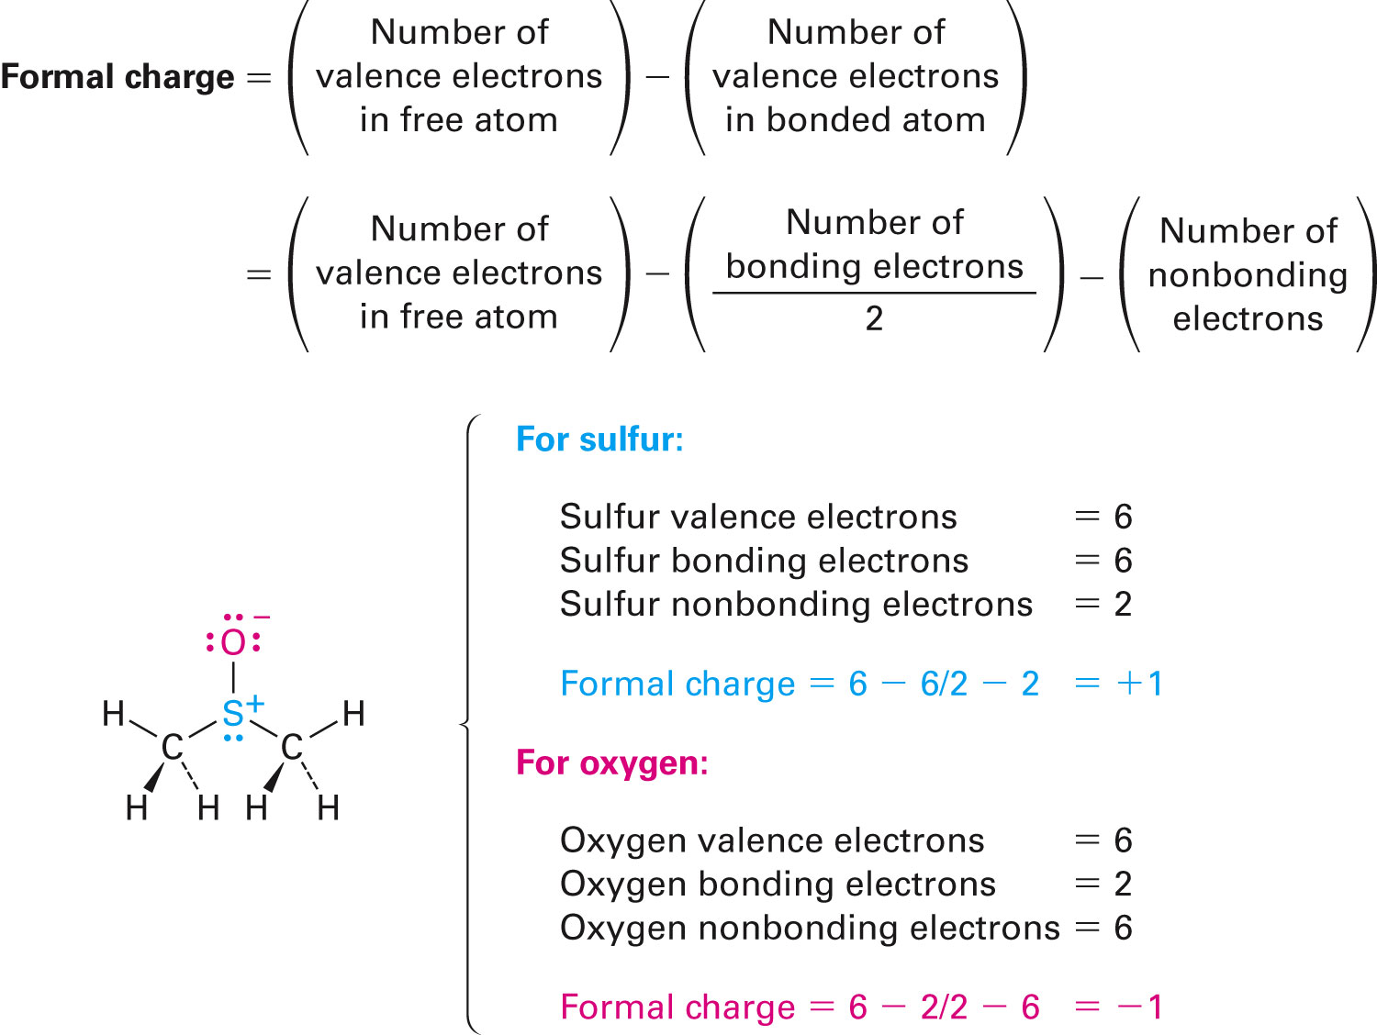
Formal Charge for Dimethyl Sulfoxide
Atomic sulfur has 6 valence electrons
Dimethyl sulfoxide sulfur has only 5
It has lost an electron and has positive charge
Notes:
Formal charges

Slide 18
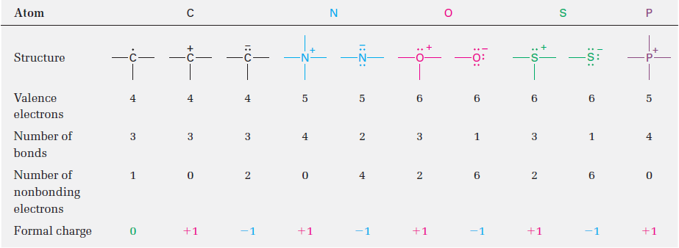
Table 2.2 - A Summary of Common Formal Charges
Notes:
Formal charges

Slide 19
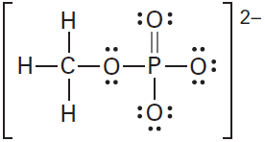
Worked Example
Calculate formal charges on the four O atoms in the methyl phosphate dianion
Solution:
# of nonbonding electrons
# of valence electrons
Notes:
Formal charges

Slide 20
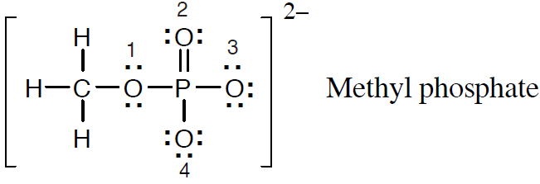
Worked Example
For oxygen 1:
For oxygen 2:
For oxygen 3:
Notes:
Formal charges

Slide 21
Worked Example
For oxygen 4:
Formal charge of oxygen atoms 1 and 2 is 0
Formal charge of oxygen atoms 3 and 4 is -1
Notes:
Formal charges

Slide 22
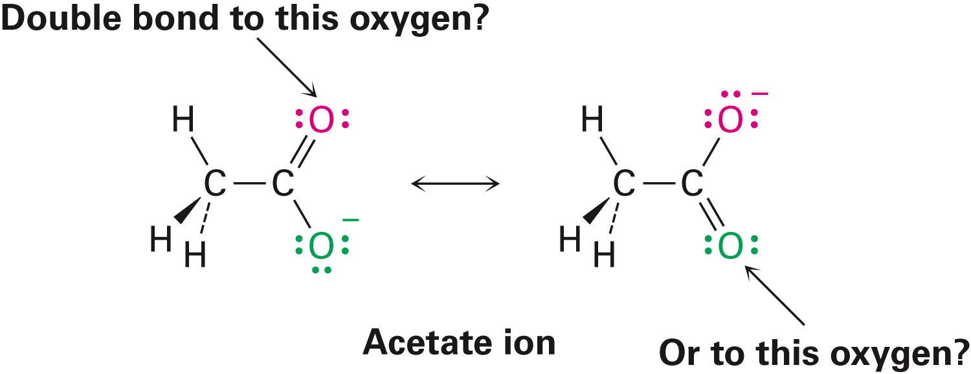
Resonance
Some molecules have structures that cannot be shown with a single representation
Represented by structures that contribute to the final structure but differ in the position of the π bond or lone pair
Such structures are delocalized and are represented by resonance forms
Notes:
Resonance

Slide 23
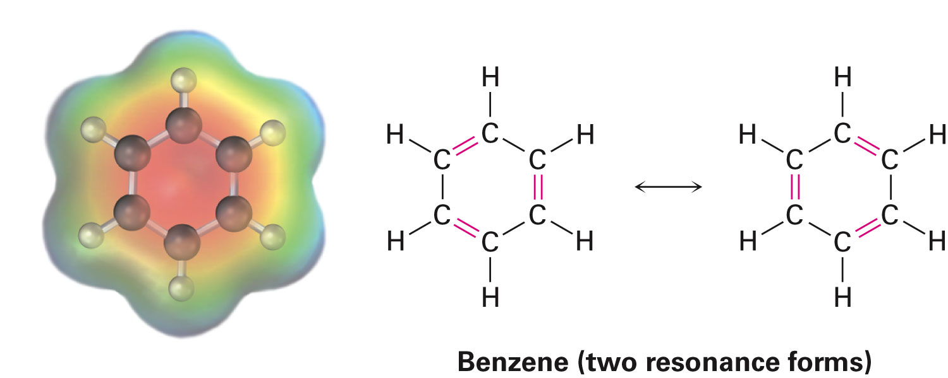
Resonance Hybrids
Structure with resonance forms, that does not alternate between the forms
Example - Benzene (C₆H₆) has two resonance forms with alternating double and single bonds
Is a hybrid of the two individual forms
All six carbon–carbon bonds are equivalent
Notes:
Resonance

Slide 24
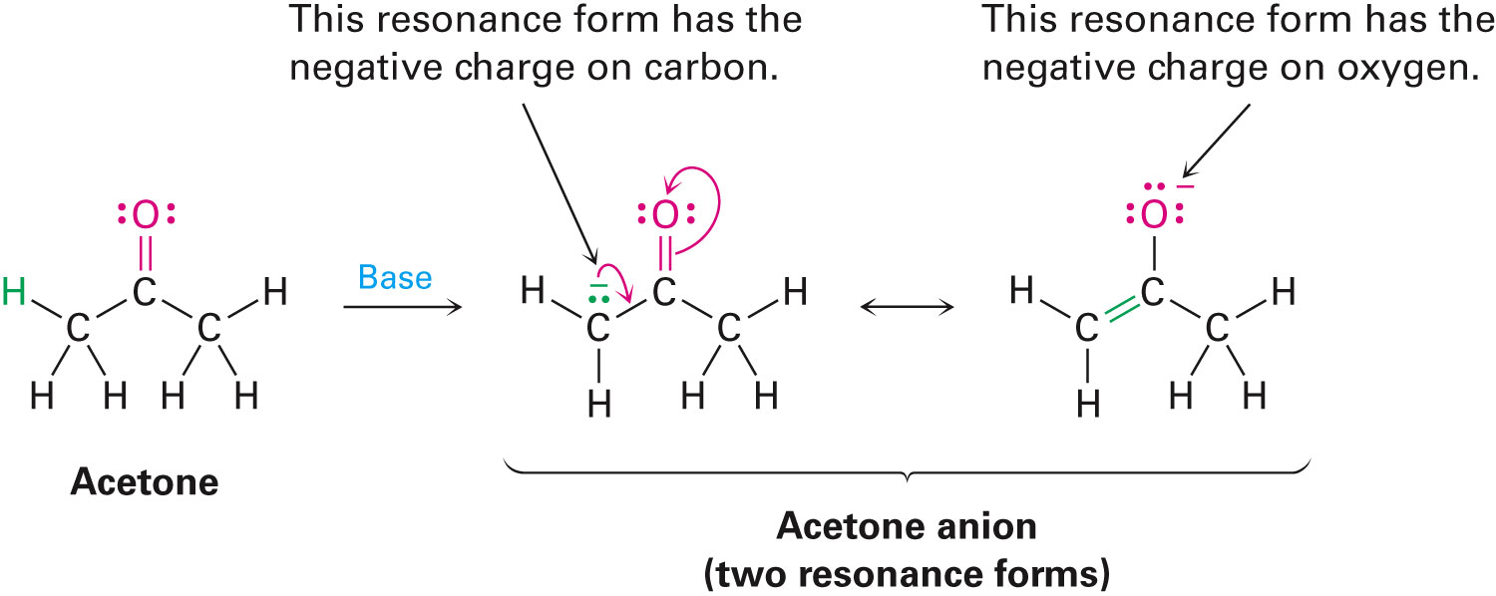
Rules for Resonance Forms
Individual resonance forms are imaginary
Real structure is a hybrid of different forms
Resonance forms differ only in the placement of their π or nonbonding electrons
Curved arrow indicates movement of electrons, not of the atoms
Notes:
Rules for resonance forms

Slide 25
Rules for Resonance Forms
Different resonance forms of a substance do not have to be equivalent
When two resonance forms are nonequivalent, the actual structure of the resonance hybrid resembles the more stable form
Resonance forms obey normal rules of valency
Resonance hybrid is more stable than any individual resonance form
Resonance leads to stability
Notes:
Rules for resonance forms

Slide 26
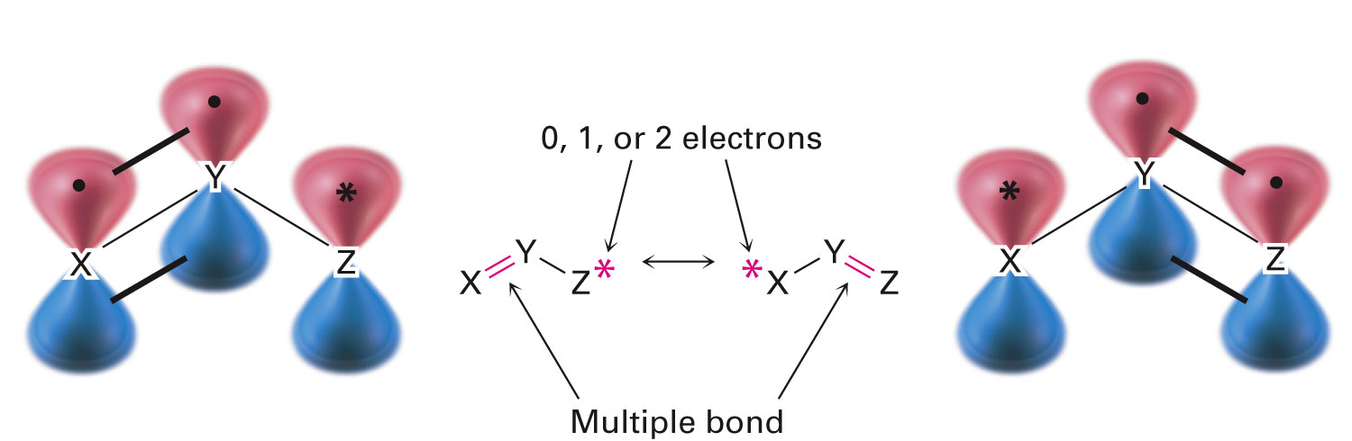
Drawing Resonance Forms
Any three-atom grouping with a p orbital on each atom has two resonance forms
Notes:
Drawing resonance forms

Slide 27
Drawing Resonance Forms
Resonance forms differ by an exchange in position of the multiple bonds and the asterisk
From one end of the three-atom grouping to the other
Recognizing three-atom groupings within larger structures help generate resonance forms, symmetrically
Notes:
Drawing resonance forms

Slide 28
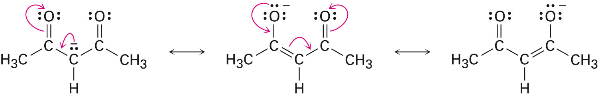
2,4-Pentanedione Anion
Has a lone pair of electrons
Has a formal negative charge on the central carbon atom, next to a C═O bond on the left and on the right
Has three resonance structures
Notes:
Drawing resonance forms

Slide 29
Worked Example
Draw the indicated number of resonance forms for:
The allyl cation, H₂C═CH CH₂²⁻ (2)
Solution:
Locating three-atom groupings that contain a multiple bond next to an atom with a p orbital
Exchanging the positions of the bond and the electrons in the p orbital, we have:
Notes:
Drawing resonance forms

Slide 30
Acids and Bases: The Brønsted-Lowry Definition
Idea that acids are solutions containing a lot of “H⁺” and bases are solutions containing a lot of “OH⁻” is not very useful in organic chemistry
Brønsted-Lowry theory defines acids and bases by their role in reactions that transfer protons (H⁺) between donors and acceptors
Notes:
Acids and bases: The Brønsted–Lowry definition

Slide 31
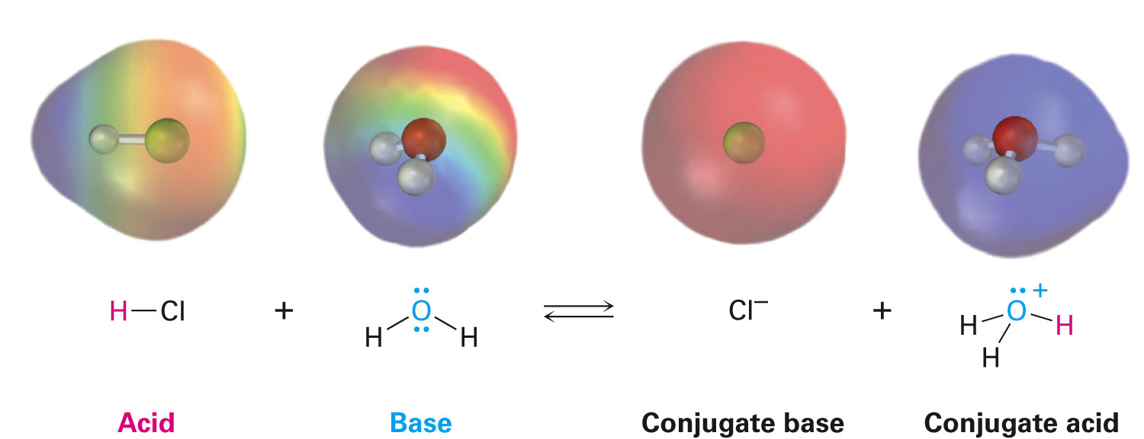
Acids and Bases: The Brønsted-Lowry Definition
Brønsted-Lowry acid: Substance that donates a hydrogen ion, H⁺
Brønsted-Lowry base: Substance that accepts a hydrogen ion, H⁺
Proton is a synonym for H⁺
Loss of valence electron from H leaves only the nucleus—a proton

Slide 32
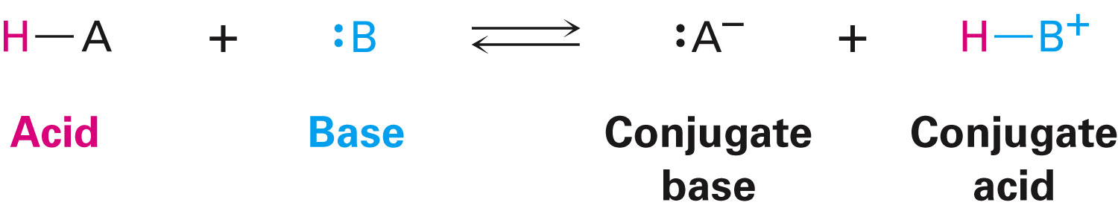
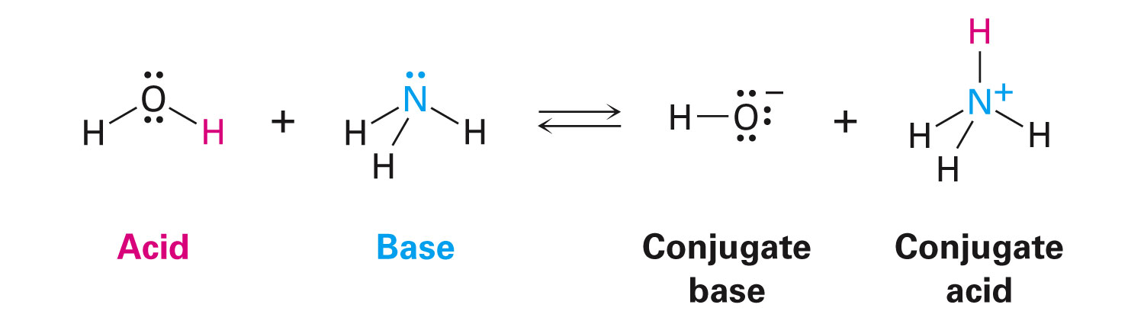
Acids and Bases: The Brønsted-Lowry Definition
Conjugate base: Product that results from deprotonation of a Brønsted-Lowry acid
Conjugate acid: Product that results from protonation of a Brønsted-Lowry base
Notes:
Acids and bases: The Brønsted–Lowry definition

Slide 33
Acid Base Strength
Acidity constant (K_{a}): Measure of acid strength
For the reaction of an acid (HA) with water to form hydronium ion
Conjugate base (A⁻) is a measure related to the strength of the acid
Brackets [ ] indicate concentration in moles per liter

Slide 34
Acid and Base Strength
Acid strengths are normally expressed using pK_{a} values
pK_{a}: Negative common logarithm of the K_{a}
Stronger acids have smaller pK_{a}
Weaker acids have larger pK_{a}
Notes:
Acid and base strength

Slide 35
Acid and Base Strength
Water is both an acid and base solvent
Ion product of water, K_{w} = [H₃O⁺][OH⁻]
Molar concentration of pure water, [H₂O] = 55.4 M at 25°C
Notes:
Acid and base strength

Slide 36
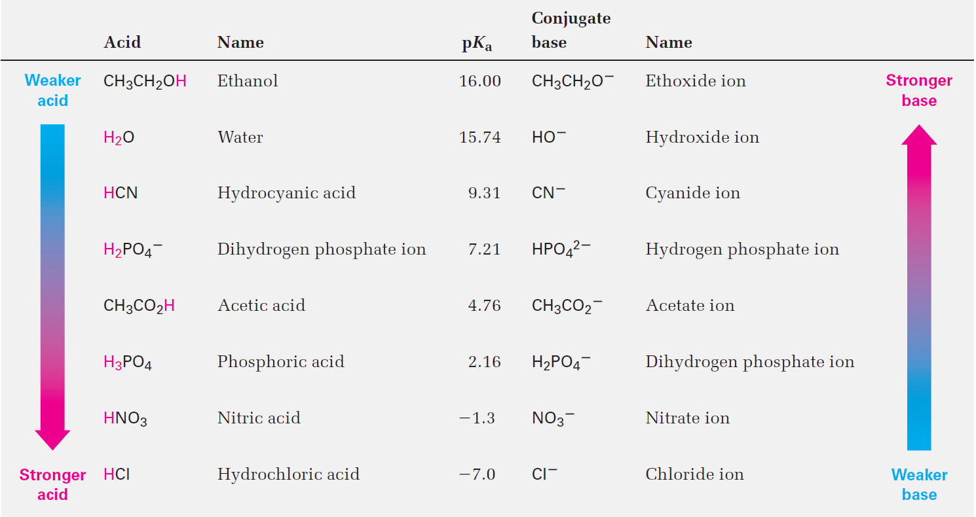
Table 2.3 - Relative Strengths of Some Common Acids and Their Conjugate Bases
Notes:
Acid and base strength

Slide 37
Worked Example
The amino acid phenylalanine has pK_{a} = 1.83, and tryptophan has pK_{a} = 2.83
Which is the stronger acid?
Solution:
Stronger acid has a smaller pK_{a} and a weaker acid has a larger pK_{a}
Accordingly, phenylalanine (pK_{a} = 1.83) is a stronger acid than tryptophan (pK_{a} = 2.83)
Notes:
Acid and base strength

Slide 38
Predicting Acid-Base Reactions from pK_{a} Values
pK_{a} values are related as logarithms to equilibrium constants
Useful for predicting whether a given acid-base reaction will take place
Difference in two pK_{a} values is the log of the ratio of equilibrium constants, and can be used to calculate the extent of transfer
Notes:
Predicting acid-base reactions from pKa values

Slide 39
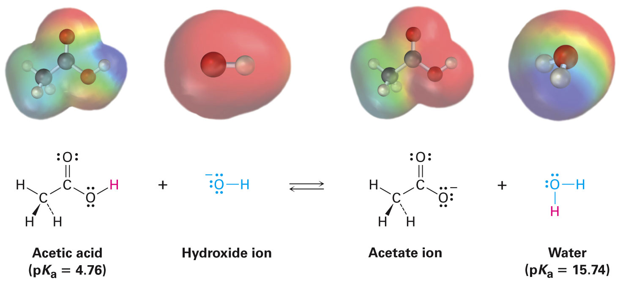
Predicting Acid-Base Reactions from pK_{a} Values
Notes:
Predicting acid-base reactions from pKa values

Slide 40
Worked Example
Will the following reaction take place to a significant extent as written, according to the data in Table 2.3?
HCN + CH₃CO₂⁻ Na⁺ → Na⁺ ⁻CN + CH₃CO₂H
Solution:
HCN + CH₃CO₂⁻ Na⁺ → Na⁺ ⁻CN + CH₃CO₂H
Since CH₃CO₂H is stronger than HCN the reaction will not take place to a significant extent the direction written
?
?
pK_{a}= 9.3
Weaker acid
pK_{a}= 4.7
Stronger acid
Notes:
Predicting acid–base reactions from pKa values

Slide 41
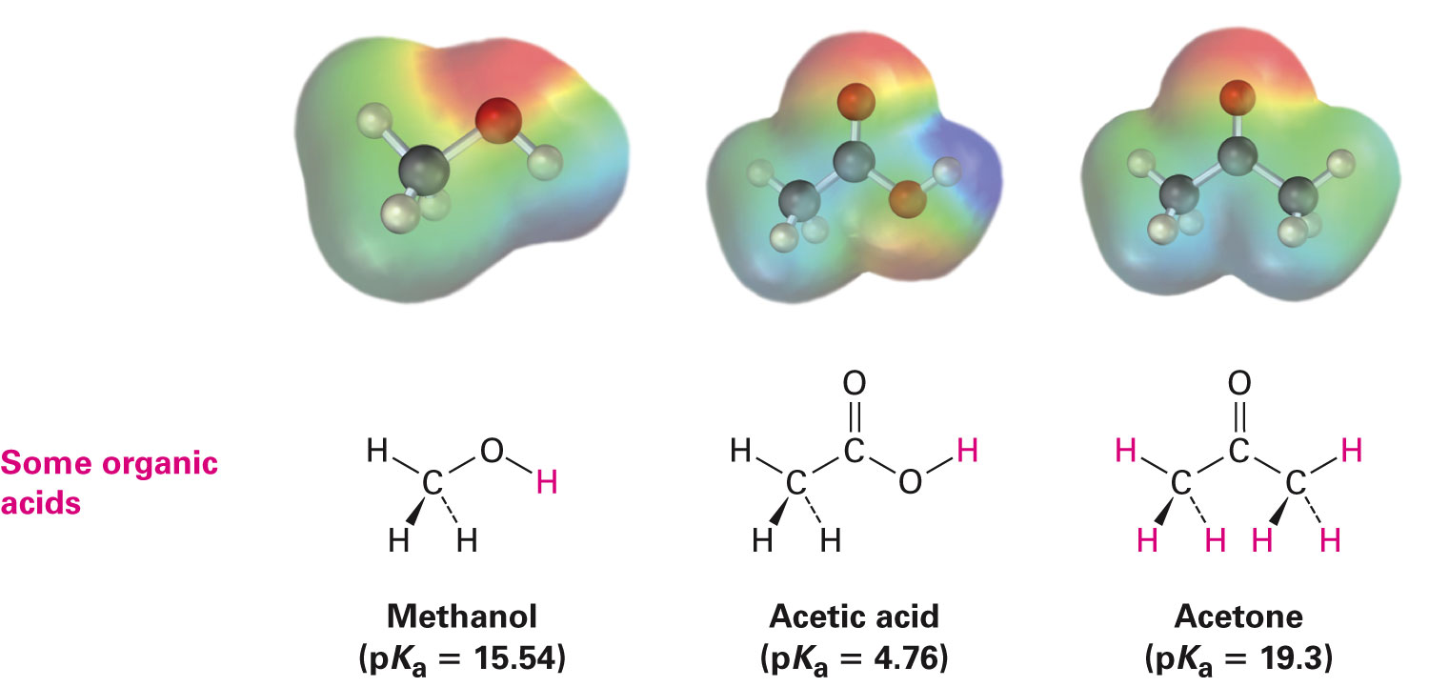
Organic Acids
Characterized by the presence of positively polarized hydrogen atom
Notes:
Organic acids and organic bases

Slide 42
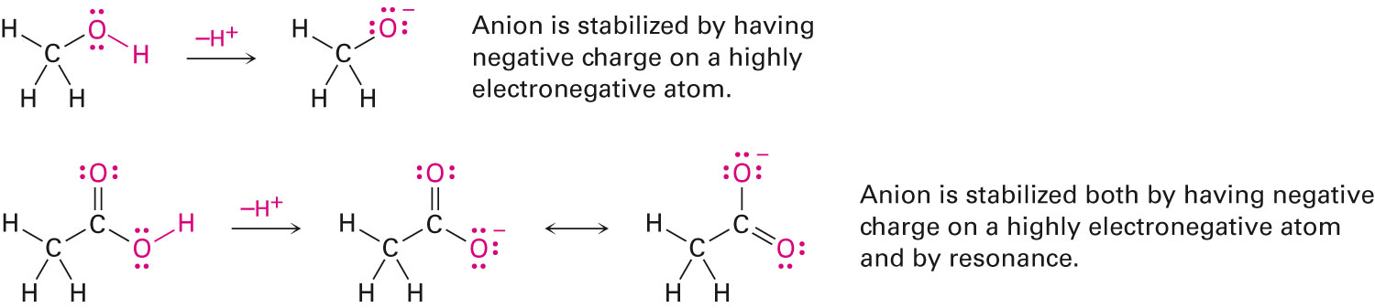
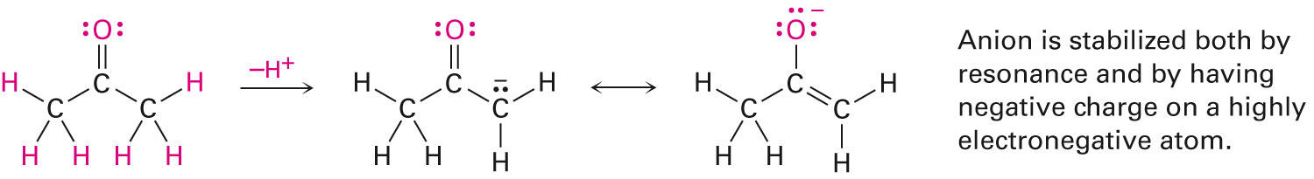
Organic Acids
Two main kinds, those that contain:
Hydrogen atom bonded to a electronegative oxygen atom(O–H)
A hydrogen atom bonded to a carbon atom next to a C═O bond(O═C─C─H)
Notes:
Organic acids and organic bases

Slide 43
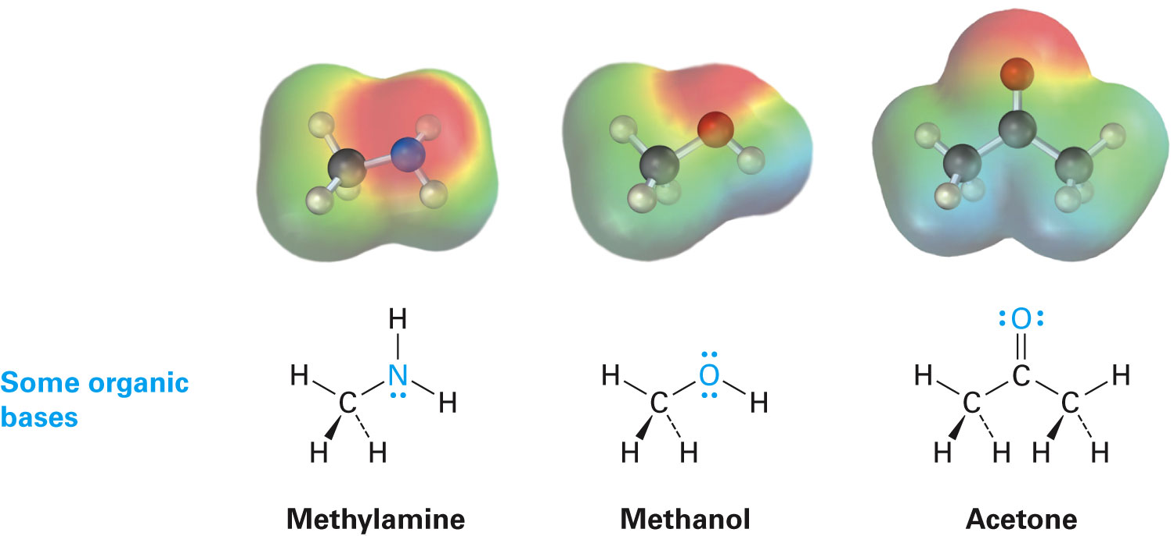
Organic Bases
Have an atom with a lone pair of electrons that can bond to H⁺
Nitrogen-containing compounds derived from ammonia are the most common organic bases
Oxygen-containing compounds can react as bases with a strong acid or as acids with strong bases
Notes:
Organic acids and organic bases

Slide 44
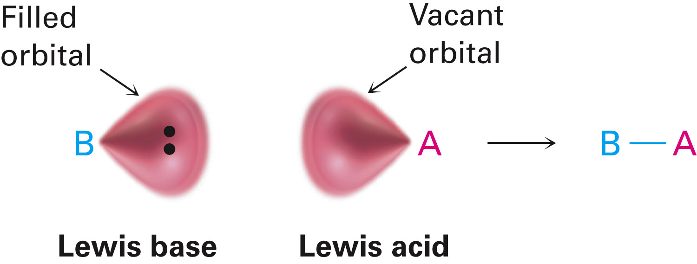
Acids and Bases: The Lewis Definition
Lewis acid: Electron pair acceptors
Lewis bases: Electron pair donors
Brønsted acids are not Lewis acids because they cannot accept an electron pair directly
Notes:
Acids and bases: The Lewis definition

Slide 45
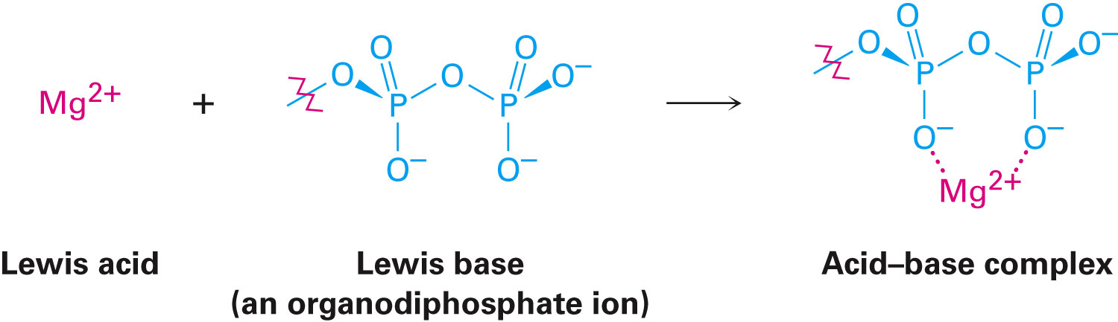
Lewis Acids and the Curved Arrow Formalism
Lewis definition of acidity includes metal cations, such as Mg²⁺
They accept a pair of electrons when they form a bond to a base
Group 3A elements, such as BF₃ and AlCl₃, are Lewis acids
Have unfilled valence orbitals and can accept electron pairs from Lewis bases
Notes:
Acids and bases: The Lewis definition

Slide 46
Lewis Acids and the Curved Arrow Formalism
Transition-metal compounds, such as TiCl₄, FeCl₃, ZnCl₂, and SnCl₄, are Lewis acids
Curved arrow means that a pair of electrons move from the atom at the tail of the arrow to the atom at the head of the arrow
Notes:
Acids and bases: The Lewis definition

Slide 47
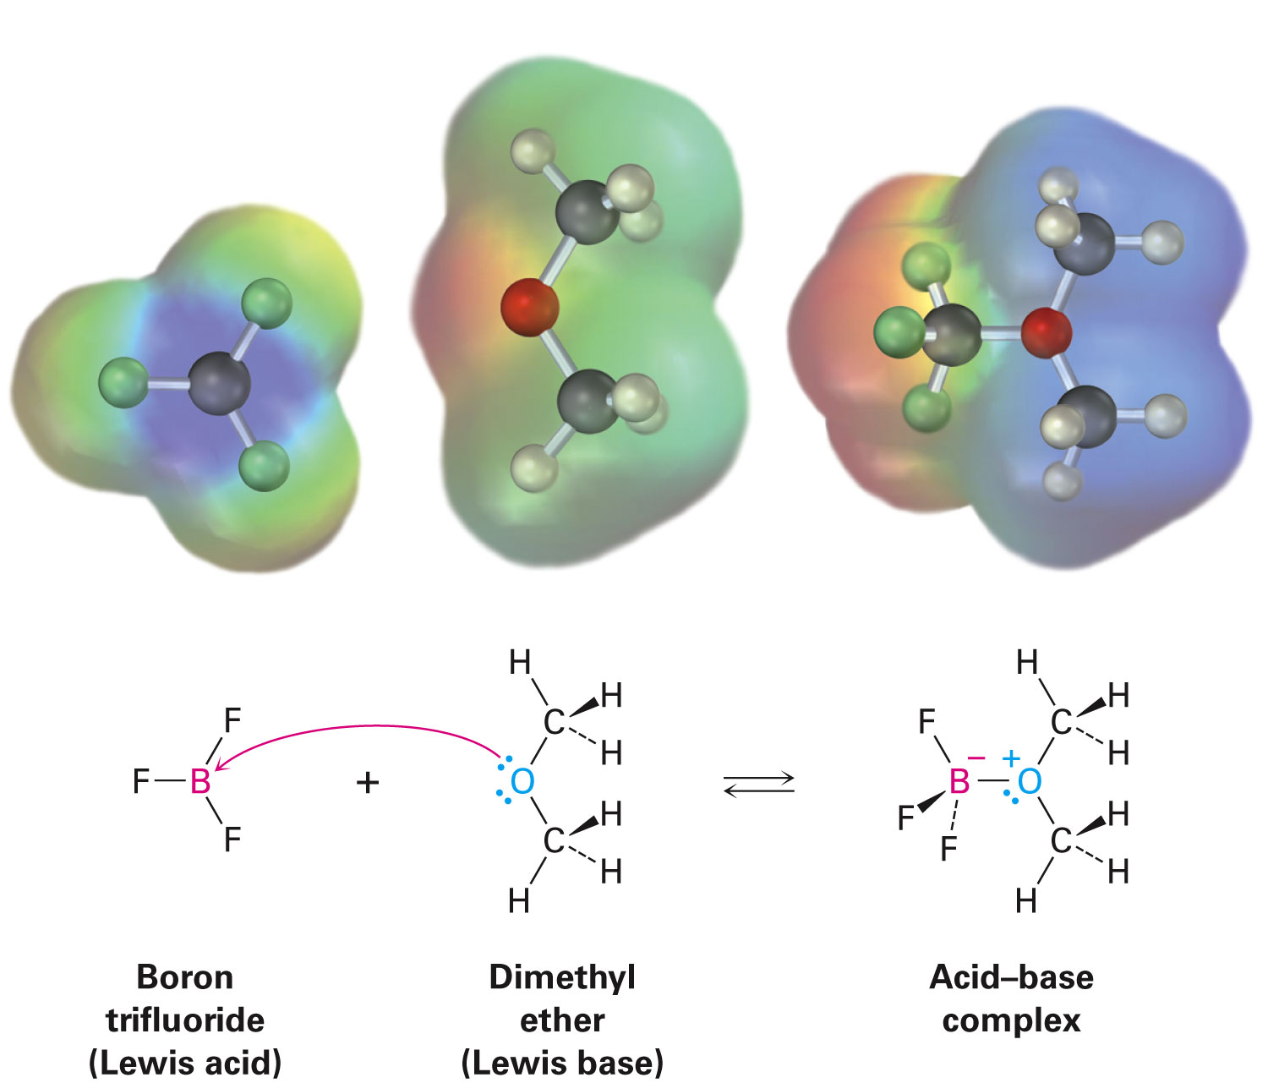
Figure 2.5 - The Reaction of Boron Trifluoride with Dimethyl Ether
Notes:
Acids and bases: The Lewis definition

Slide 48
Lewis Bases
Compound with a pair of nonbonding electrons that it can use to bond to a Lewis acid
Can accept protons as well as Lewis acids
Definition encompasses that for Brønsted bases
Oxygen-and nitrogen-containing organic compounds are Lewis bases; they have lone pairs of electrons
Some compounds can act as both acids and bases
Notes:
Acids and bases: The Lewis definition

Slide 49
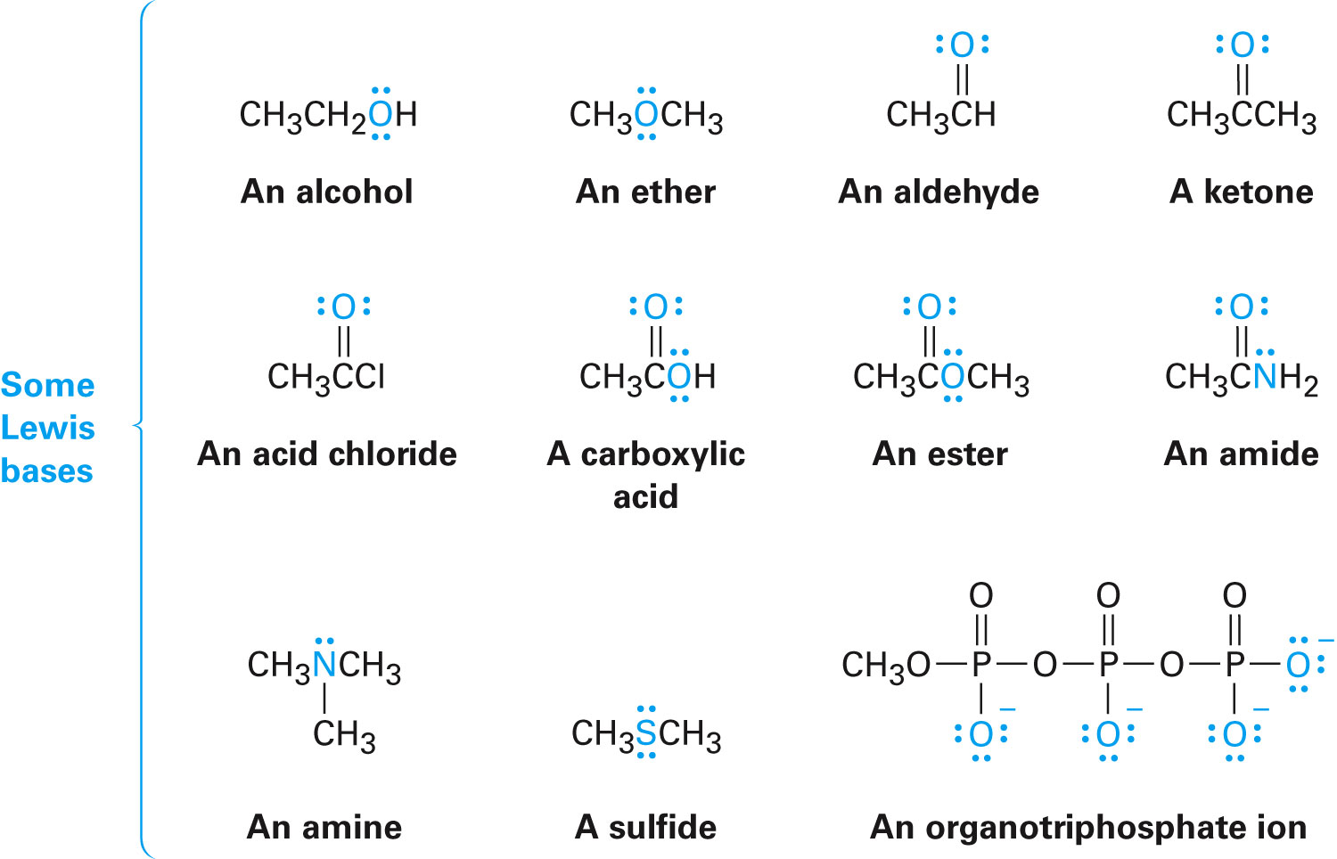
Lewis Bases
Notes:
Acids and bases: The Lewis definition

Slide 50
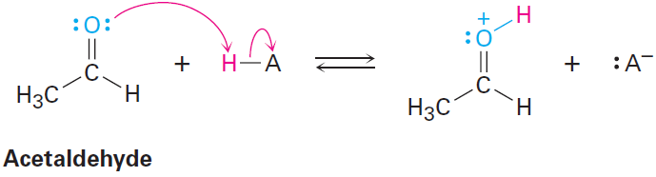
Worked Example
Using curved arrows, show how acetaldehyde, CH₃CHO, can act as a Lewis base
Solution:
A Lewis base donates an electron pair to a Lewis acid
Using a curved arrow to show the movement of a pair toward the H atom of the acid
Notes:
Acids and bases: The Lewis definition

Slide 51
Noncovalent Interactions Between Molecules
Noncovalent interactions: One of a variety of nonbonding interactions between molecules
Dipole–dipole forces
Dispersion forces
Hydrogen bonds
Notes:
Noncovalent interactions between molecules

Slide 52
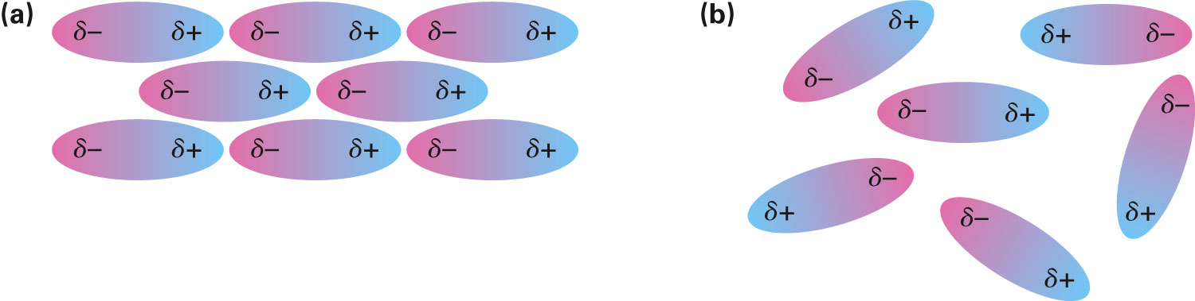
Dipole–Dipole Forces
Occur between polar molecules as a result of electrostatic interactions among dipoles
Depending on orientation of the molecules, the forces can be either attractive or repulsive
Notes:
Noncovalent interactions between molecules

Slide 53
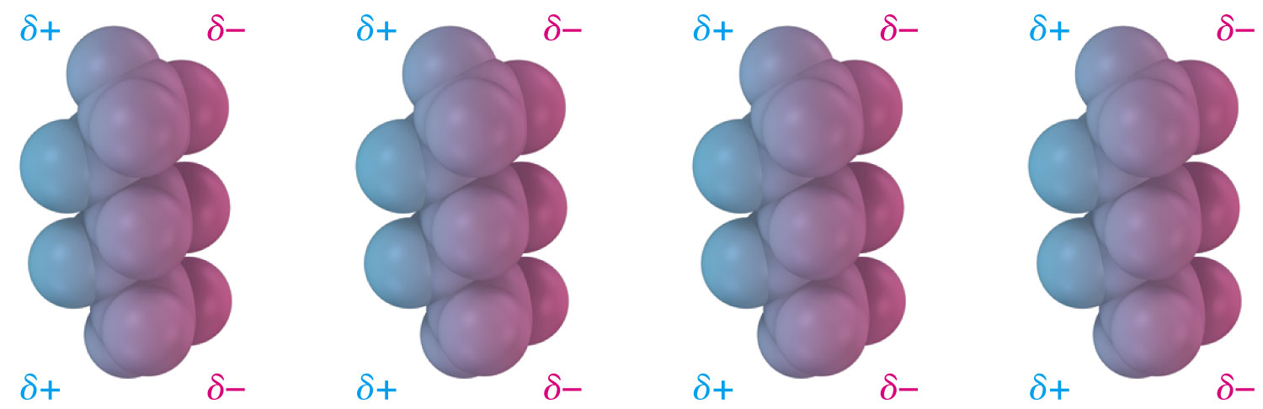
Dispersion Forces
Occur between all neighboring molecules
Arise due to constant change in electron distribution within molecules
Notes:
Noncovalent interactions between molecules

Slide 54
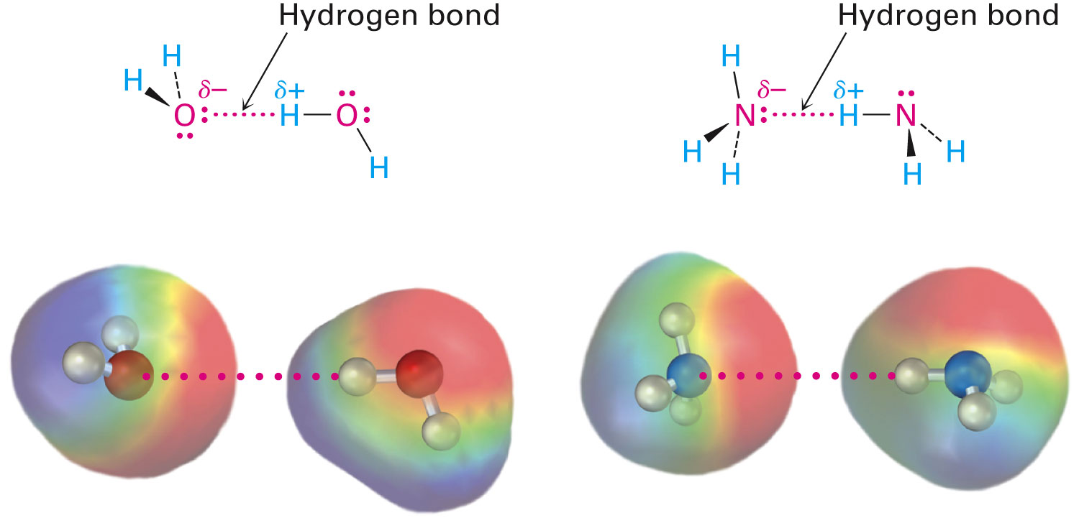
Hydrogen Bond Forces
Forces are the result of attractive interaction between a hydrogen bonded to an electronegative O or N atom and an unshared electron pair on another O or N atom
Notes:
Noncovalent interactions between molecules

Slide 55
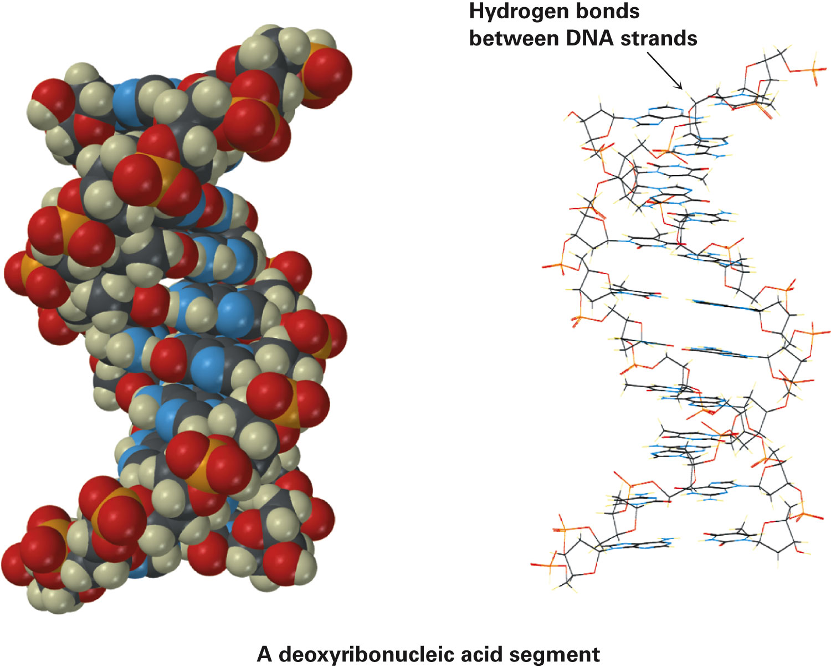
A Deoxyribonucleic Acid Segment
Notes:
Noncovalent interactions between molecules

Slide 56
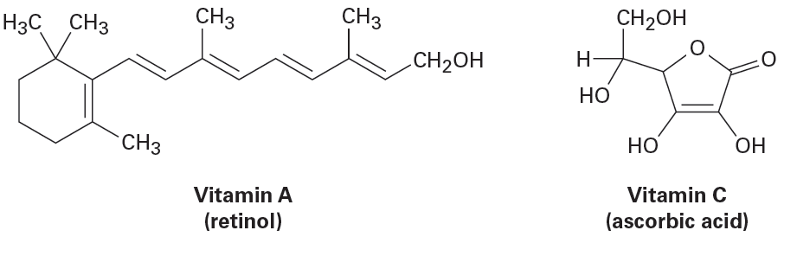
Worked Example
Of the two vitamins A and C, one is hydrophilic and water-soluble while the other is hydrophobic and fat-soluble
Which is which?
Notes:
Noncovalent interactions between molecules

Slide 57
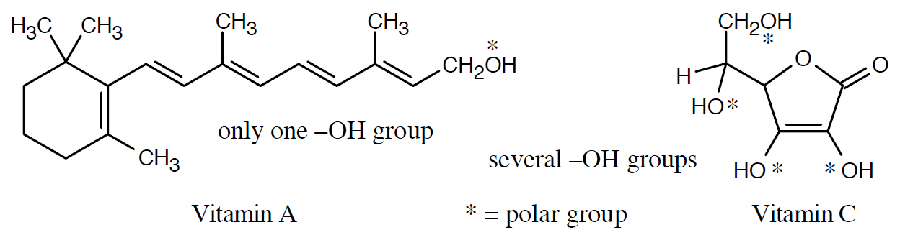
Worked Example
Solution:
Vitamin C has several polar ─OH groups that can form hydrogen bonds with water
It is water soluble(hydrophilic)
Most of Vitamin A’s atoms can’t form hydrogen bonds with water
It is fat-soluble(hydrophobic)
Notes:
Noncovalent interactions between molecules

Slide 58
Summary
Organic molecules often have polar covalent bonds as a result of unsymmetrical electron sharing caused by differences in the electronegativity of atoms
Polarity of a molecule is measured by its dipole moment, μ
(+) and (−) indicate formal charges on atoms in molecules to keep track of valence electrons around an atom

Slide 59
Summary
Some substances must be shown as a resonance hybrid of two or more resonance forms that differ by the location of electrons
A Brønsted(–Lowry) acid donates a proton
A Brønsted(–Lowry) base accepts a proton
Strength of Brønsted acid is related to the negative logarithm of the acidity constant, pK_{a}
Weaker acids have higher values of pK_{a}

Slide 60
Summary
Lewis acid has an empty orbital that can accept an electron pair
Lewis base can donate an unshared electron pair
Noncovalent interactions have several types – Dipole–dipole, dispersion, and hydrogen bond forces

